Slide 1
Point Estimates and Sampling Variability
Dr. Ab Mosca (they/them)
Slides based off slides courtesy of OpenIntro and John McGreedy of Johns Hopkins University

Slide 2
Examples: Sampling Distribution of the Sample Mean

Slide 3
Learning Objectives
Upon completion of this lecture section, you will be able to:
Describe the sampling distribution of a sample mean in terms of its composition
Comment on some characteristics of the sampling distributions for sample means demonstrated empirically, by simulations, including
General shape of the distributions
Center of the distributions
Variability of the distributions and the relationship to the size of the samples each mean is based upon

Slide 4
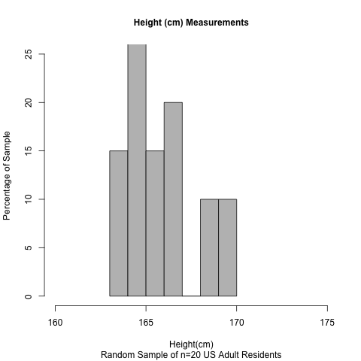
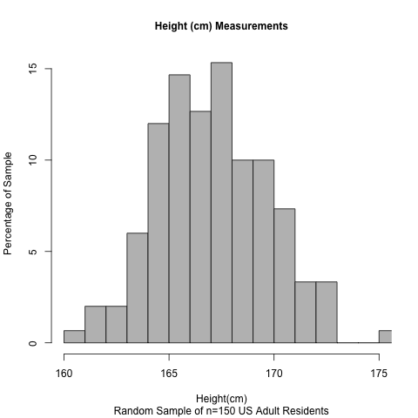
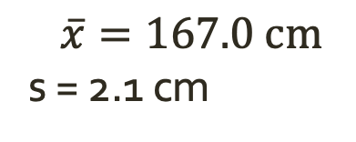
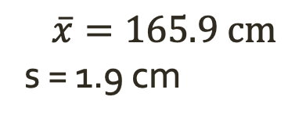
Example: Heights of US Adults
Two random samples of sizes n=20 and n=50, respectively
$$\overline{x}=167.0 \text{cm}$$
s = 2.1 cm
$$\overline{x}=165.9 \text{cm}$$
s = 1.9 cm

Slide 5
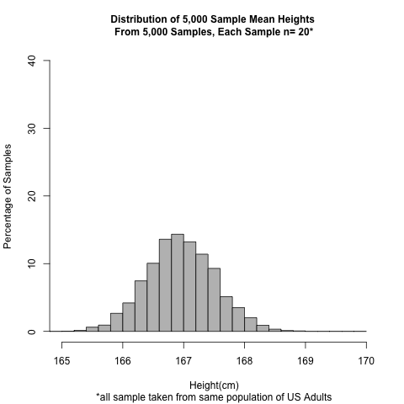
Example: Estimated Sampling Distribution of Mean Heights from 5,000 Random Samples of Size n=20

Slide 6
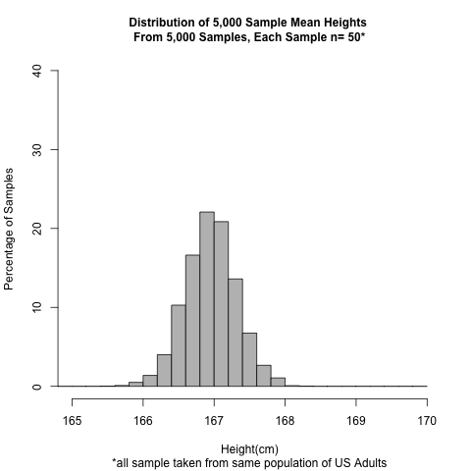
Example: Estimated Sampling Distribution of Mean Heights from 5,000 Random Samples of Size n=50

Slide 7
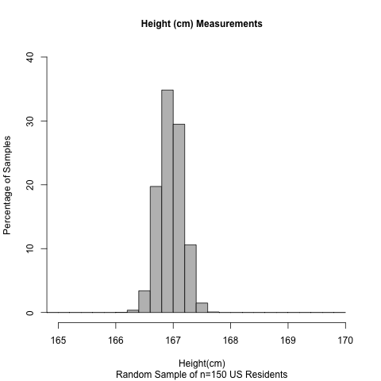
Example: Estimated Sampling Distribution of Mean Heights from 5,000 Random Samples of Size n=150

Slide 8
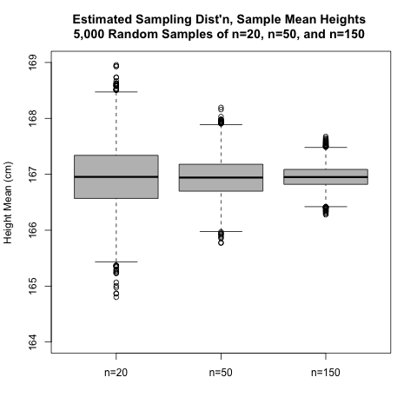
Estimated Sampling Distribution of Mean Heights Compared in Side-by-Side Boxplot

Slide 9
Summary Statistics for Each Estimated Sampling Distribution: Height Means
The true population mean height is 167 cm
Here are the means and standard deviations of the sample means in each simulated sampling distribution:
Sample size | Mean of 5,000 sample means | SD of 5,000 sample means*
n=20 | 167 cm | 0.57 cm
n=50 | 167 cm | 0.35 cm
n=150 | 167 cm | 0.20 cm
*Soon, we refer to this as the standard error of the sample mean

Slide 10
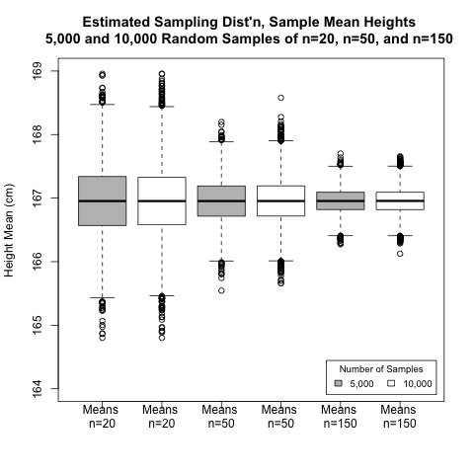
Note about Variation in Sample Mean Values
The variation in sample means depends on size of each sample, not number of samples taken in the simulation

Slide 11
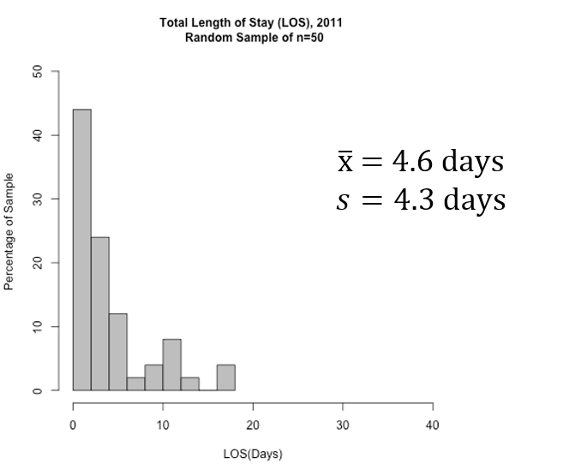
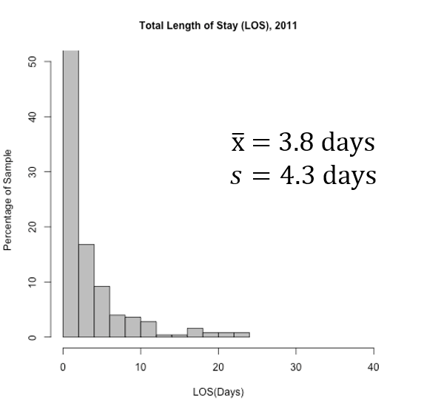
Example: Length of Stay in 2011 , Heritage Health Enrollees Who Were Hospitalized at Least Once

Slide 12
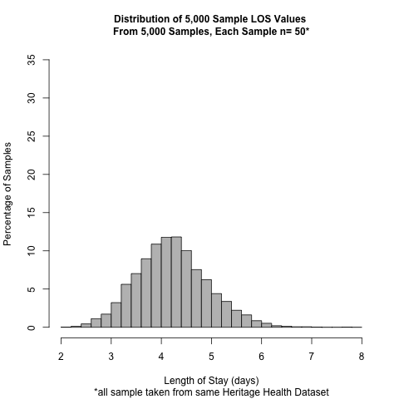
Example: Estimated Sampling Distribution of Mean LOS from 5,000 Random Samples of Size n=50

Slide 13
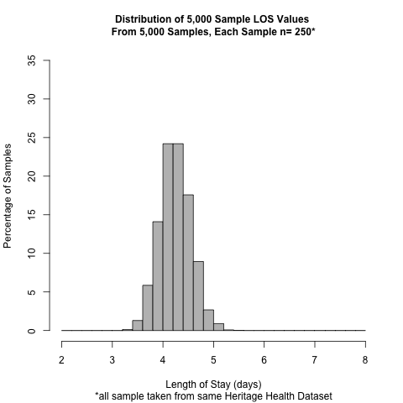
Example: Estimated Sampling Distribution of Mean LOS from 5,000 Random Samples of Size n=250

Slide 14

Example: Estimated Sampling Distribution of Mean LOS from 5,000 Random Samples of Size n=400

Slide 15
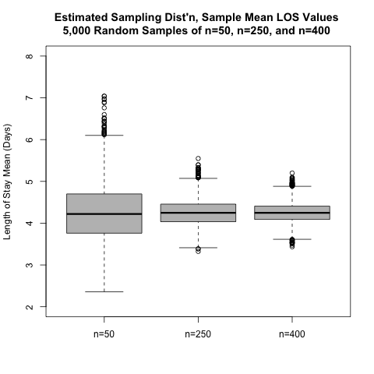
Estimated Sampling Distribution of Mean LOSs Compared in Side-by-Side Boxplot

Slide 16
Summary Statistics for Each Estimated Sampling Distribution: LOS Means
The true population mean length of stay (LOS) is 4.25 days
Here are the means and standard deviations of the sample means in each simulated sampling distribution:
Sample size | Mean of 5,000 sample means | SD of 5,000 sample means*
n=50 | 4.22 days | 0.71 days
n=250 | 4.25 days | 0.31 days
n=400 | 4.25 days | 0.24 days
*Soon, we refer to this as the standard error of the sample mean

Slide 17
Summary—1
Theoretical sampling distributions for sample means across random samples of the same size, from the same population, can be estimated via computer simulation
Simulation is a useful tool for helping explore the properties of these sampling distributions. Some properties observed with the two examples in this lecture, which will be generalized shortly, include:

Slide 18
Summary—2
Ultimately, estimating the characteristics of a sampling distribution will be done using the results from a single random sample from a population. Later in this lecture set, the properties that have been demonstrated empirically via the simulations in this section will be generalized

Slide 19
Examples: Sampling Distribution of Sample Proportions and Sample Incidence Rates

Slide 20
Learning Objectives—1
Upon completion of this lecture section, you will be able to:
Describe the sampling distribution of a sample proportion and a sample incidence rate, in terms of their compositions
Comment on some characteristics of the sampling distributions for proportions and incidence rates, demonstrated empirically, by simulations, including:
General shape of the distributions
Center of the distributions
Variability of the distributions, and the relationship to the size of the samples each statistic is based upon

Slide 21
Learning Objectives—2
Upon completion of this lecture section, you will be able to:
Comment on the similarities between this lecture section’s results and the results for sampling distributions of sample means from the previous section

Slide 22
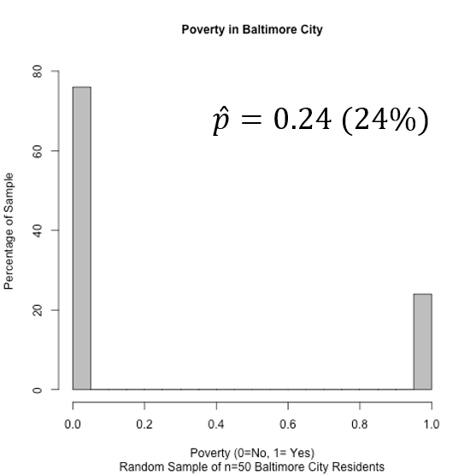
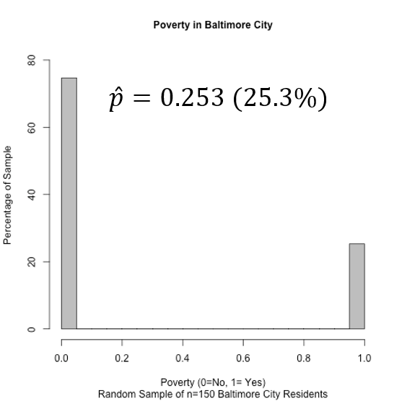
Example: Poverty in Baltimore

Slide 23
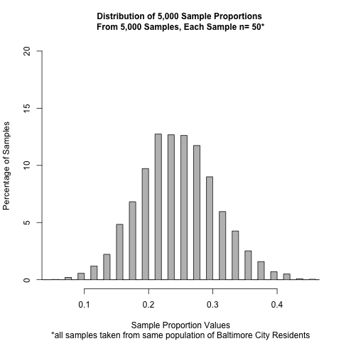
Example: Estimated Sampling Distribution of Proportion in Poverty from 5,000 Random Samples of Size n=50

Slide 24
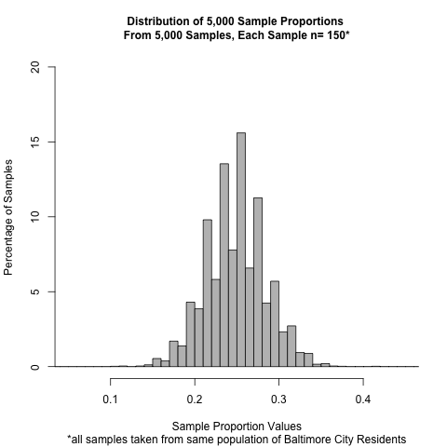
Example: Estimated Sampling Distribution of Proportion in Poverty from 5,000 Random Samples of Size n=150

Slide 25
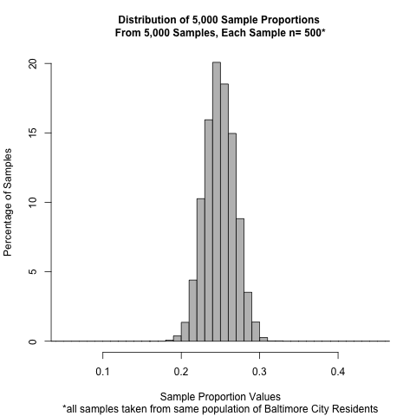
Example: Estimated Sampling Distribution of Proportion in Poverty from 5,000 Random Samples of Size n=500

Slide 26
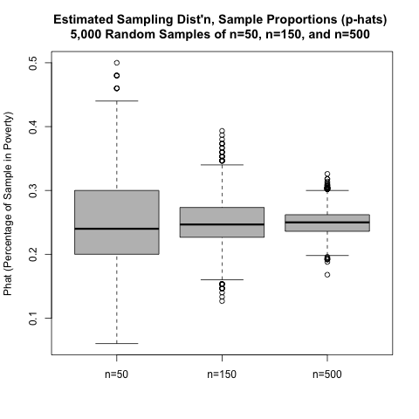
Estimated Sampling Distribution of p-hats Compared in Side-by-Side Boxplot

Slide 27
Summary Statistics for Each Estimated Sampling Distribution of the Sample Proportion
The true population proportion is 0.25 (25%)
Here are the means and standard deviations of the sample proportions in each simulated sampling distribution:
Sample size | Mean of 5,000 sample proportions | SD of 5,000 sample proportions*
n=50 | 0.25 | 0.061
n=150 | 0.25 | 0.035
n=500 | 0.25 | 0.019
*Soon, we refer to this as the standard error of the sample proportion

Slide 28
Example: Time to Relapse (Incidence Rates)—1
The University of Massachusetts Research Unit (UMARU) IMPACT Study includes data on time to relapse for persons discharged from alcohol and drug rehabilitation facilities
Data available on each participant include follow-time (time to relapse or censoring) and whether the participant relapsed (or was censored)
We will investigate the sampling behavior of a sample incidence rate using multiple samples of sizes 50, 100, and 250, respectively, taken from this dataset
Source: Hosmer, D. W., Lemeshow, S., and May, S. (2008). Applied survival analysis: Regression modeling of time to event data (2nd ed.). New York: John Wiley and Sons Inc.

Slide 29
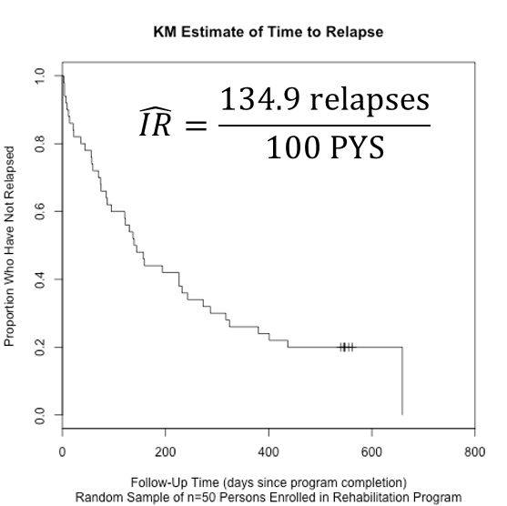
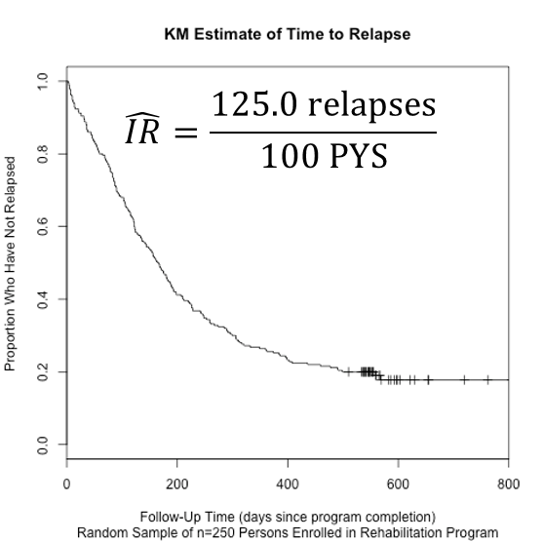
Example: Time to Relapse (Incidence Rates)—2

Slide 30
Example: Estimated Sampling Distribution of Incidence Rates of Relapse from 5,000 Random Samples of Size n=50

Slide 31
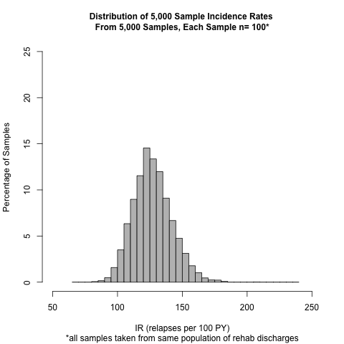
Example: Estimated Sampling Distribution of Incidence Rate of Relapse from 5,000 Random Samples of Size n=100

Slide 32
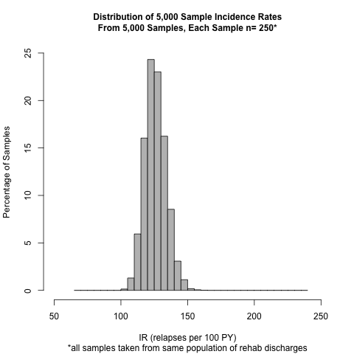
Example: Estimated Sampling Distribution of Incidence Rate of Relapse from 5,000 Random Samples of Size n=250

Slide 33
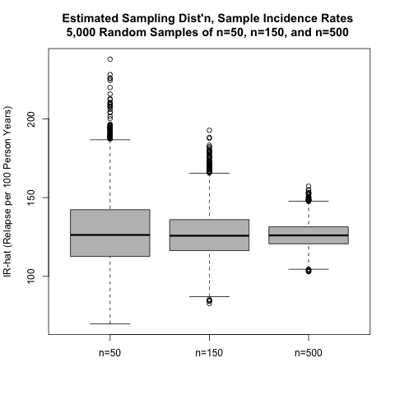
Estimated Sampling Distribution of IR-hats Compared in Side-by-Side Boxplot

Slide 34
Summary Statistics for Each Estimated Sampling Distribution of the Sample Incidence Rates
The true population IR is 125.8 relapses per 100 Person Years (PYs)
Here are the means and standard deviations of the sample IRs in each simulated sampling distribution:
Sample size | Mean of 5,000 IRs | SD of 5,000 IRs*
n=50 | 128.6 | 22.7
n=100 | 126.6 | 14.8
n=250 | 126.2 | 8.1
*Soon, we refer to this as the standard error of the sample incidence rate

Slide 35
Summary—1
Theoretical sampling distributions for sample proportions (and incidence rates) across random samples of the same size, from the same population, can be estimated via computer simulation
Simulation is a useful tool for helping explore the properties of these sampling distributions. Some properties observed with the two examples in this lecture set, which will be generalized shortly, include:

Slide 36
Summary—2
Ultimately, estimating the characteristics of a sampling distribution will be done using the results from a single random sample from a population
In the next lecture section, these properties that have been demonstrated empirically—via the simulations in this section and the previous section—will be generalized

Slide 37
Parameter estimation
We are often interested in population parameters.
Since complete populations are difficult (or impossible) to collect data on, we use sample statistics as point estimates for the unknown population parameters of interest.
Sample statistics vary from sample to sample.
Quantifying how sample statistics vary provides a way to estimate the margin of error associated with our point estimate.
But before we get to quantifying the variability among samples, let's try to understand how and why point estimates vary from sample to sample.
Suppose we randomly sample 1,000 adults from each state in the US. Would you expect the sample means of their heights to be the same, somewhat different, or very different?

Slide 38
Suppose we randomly sample 1,000 adults from each state in the US. Would you expect the sample means of their heights to be the same, somewhat different, or very different?

Slide 39
Suppose we randomly sample 1,000 adults from each state in the US. Would you expect the sample means of their heights to be the same, somewhat different, or very different?
Not the same, but only somewhat different.

Slide 40
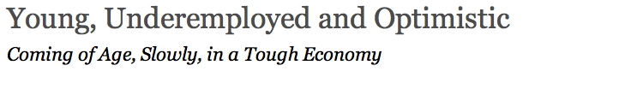
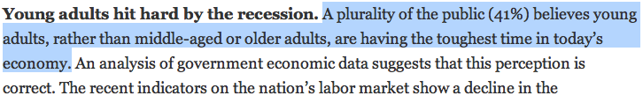
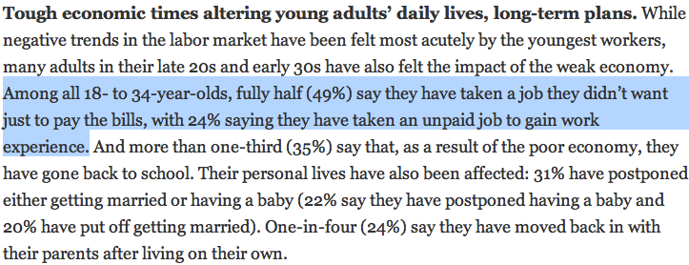
http://pewresearch.org/pubs/2191/young-adults-workers-labor-market-pay-careers-advancement-recession

Slide 41
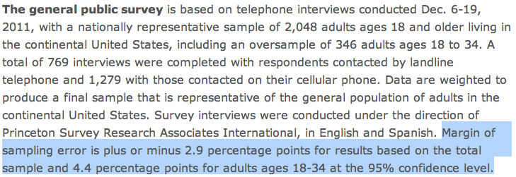
Margin of error
41% ± 2.9%: We are 95% confident that 38.1% to 43.9% of the public believe young adults, rather than middle-aged or older adults, are having the toughest time in today's economy.
49% ± 4.4%: We are 95% confident that 44.6% to 53.4% of 18-34 years olds have taken a job they didn't want just to pay the bills.

Slide 42
Suppose the proportion of American adults who support the expansion of solar energy is p = 0.88, which is our parameter of interest. Is a randomly selected American adult more or less likely to support the expansion of solar energy?

Slide 43
Suppose the proportion of American adults who support the expansion of solar energy is p = 0.88, which is our parameter of interest. Is a randomly selected American adult more or less likely to support the expansion of solar energy?
More likely.

Slide 44
Suppose that you don’t have access to the populaion of all Ameri- can adults, which is a quite likely scenario. In order to estimate the proportion of American adults who support solar power expansion, you might sample from the population and use your sample propor- tion as the best guess for the unknown population proportion.
Sample, with replacement, 1000 American adults from the population, and record whether they support solar power or not expansion.
Find the sample proportion.
Plot the distribution of the sample proportions obtained by members of the lass.

Slide 45
# 1. Create a set of 250 million entries, where 88% of
# them are "support" and 12% are "not".
pop_size <- 250000000
possible_entries <- c(rep("support", 0.88 * pop_size),
rep("not", 0.12 * pop_size))
# 2. Sample 1000 entries without replacement.
sampled_entries <- sample(possible_entries, size = 1000)
# 3. Compute p-hat: count the number that are "support",
# then divide by # the sample size.
sum(sampled sampled_entries == "support") / 1000

Slide 46
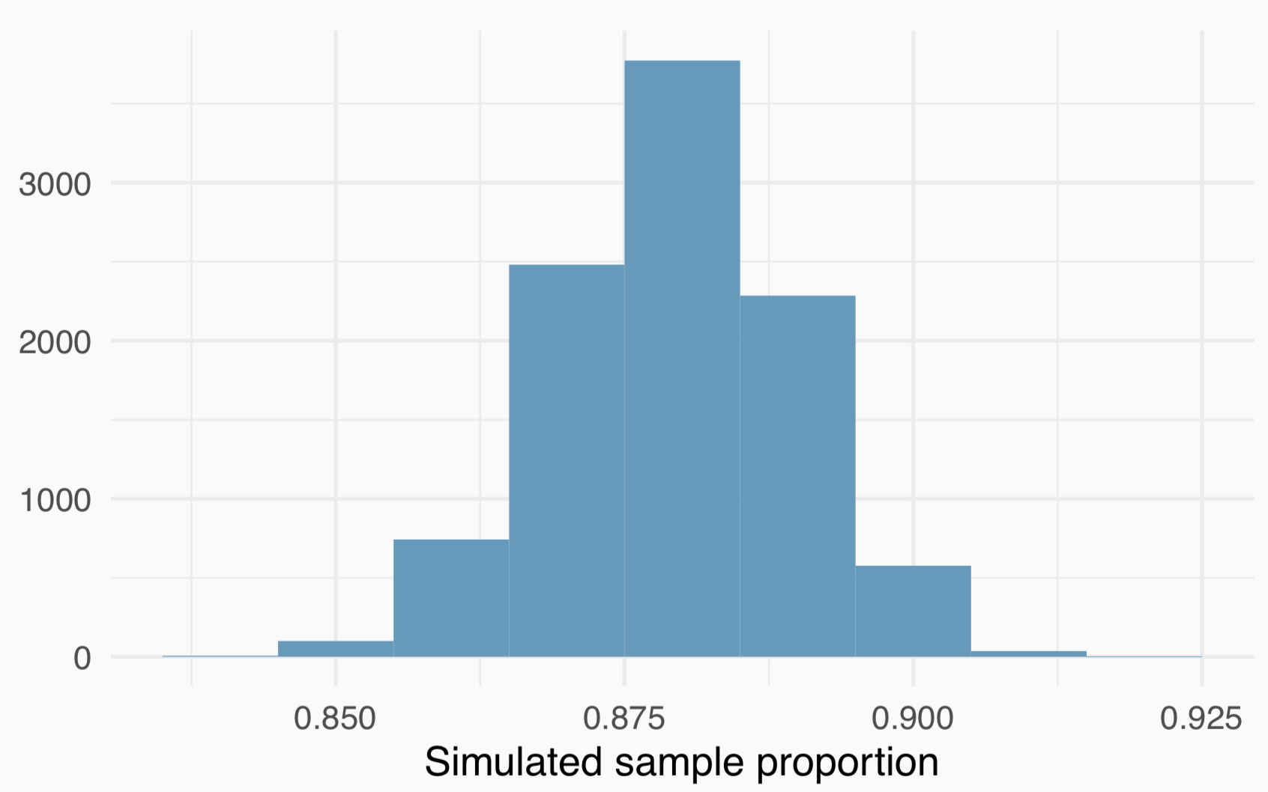
Sampling distribution
Suppose you were to repeat this process many times and plot the results. What you just constructed is called a sampling distribution.

Slide 47
Sampling distribution
What is the shape and center of this distribution?
The distribution looks symmetric and somewhat bell-shaped.

Slide 48
Sampling distribution
Based on this distribution, what do you think is the true population proportion?
The center of the distribution: about 0.88.

Slide 49
Sampling distributions are never observed
In real-world applications, we never actually observe the sampling distribution, yet it is useful to always think of a point estimate as coming from such a hypothetical distribution.
Understanding the sampling distribution will help us characterize and make sense of the point estimates that we do observe.

Slide 50
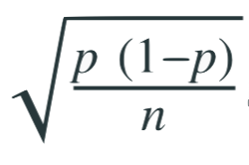
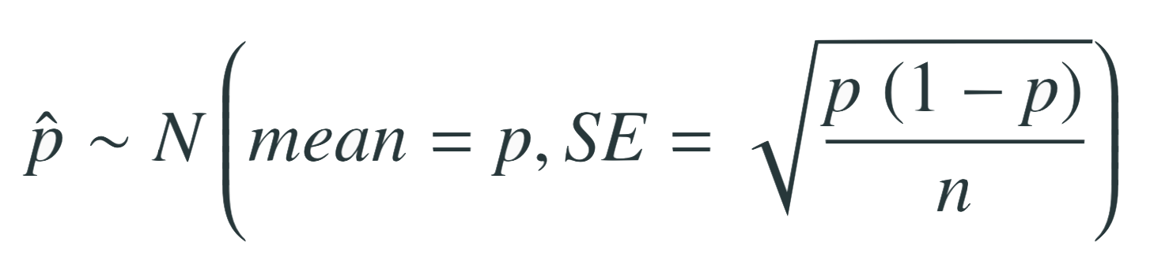
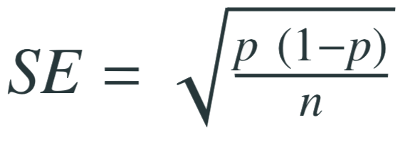
Central Limit Theorem
Sample proportions will be nearly normally distributed with mean equal to the population proportion, p, and standard error equal to
It wasn’t a coincidence that the sampling distribution we saw earlier was symmetric, and centered at the true population population.
We won’t go through a detailed proof of why
but note that as n increases SE decreases.
As n increases samples will yield more consistent p̂s, i.e. variability among p̂s will be lower.

Slide 51
CLT - conditions
Certain conditions must be met for the CLT to apply:
Independence
Sampled observations must be independent. This is difficult to verify, but is more likely if
random sampling/assignment is used, and
if sampling without replacement, n < 10% of the population.
Sample size
There should be at least 10 expected successes and 10 expected failures in the observed sample.
This is difficult to verify if you don’t know the population proportion (or can’t assume a value for it). In those cases we look for the number of observed successes and failures to be at least 10.

Slide 52
When p is unknown
The CLT states
with the condition that np and n(1 − p) are at least 10.
However, we often don’t know the value of p, the population proportion.
In these cases we substitute p̂ for p.

Slide 53
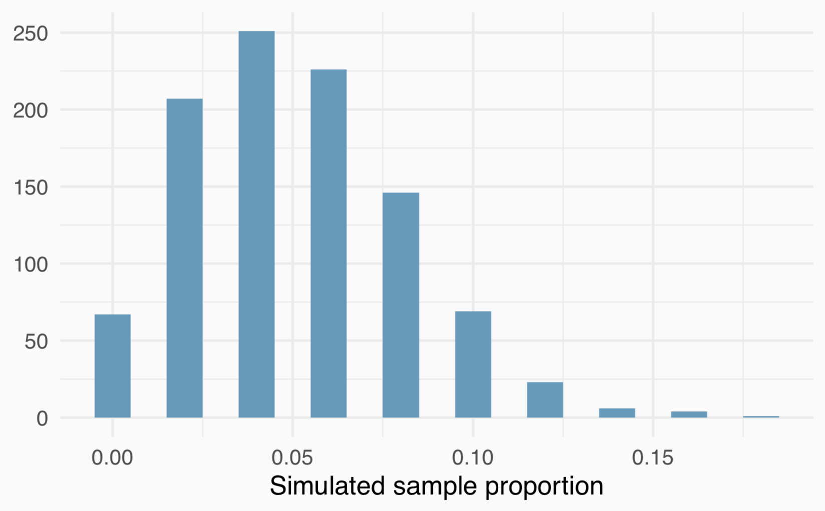
When np or n(1 - p) is small
Suppose we have a population where the true population proportion is p = 0.05, and we take random samples of size n = 50 from this population. We calculate the sample proportion in each sample and plot these proportions. Would you expect this distribution to be nearly normal? Why, or why not?
No, the success-failure condition is not met (50 x 0.05 = 2.5), so we would not expect the sampling distribution to be nearly normal.

Slide 54
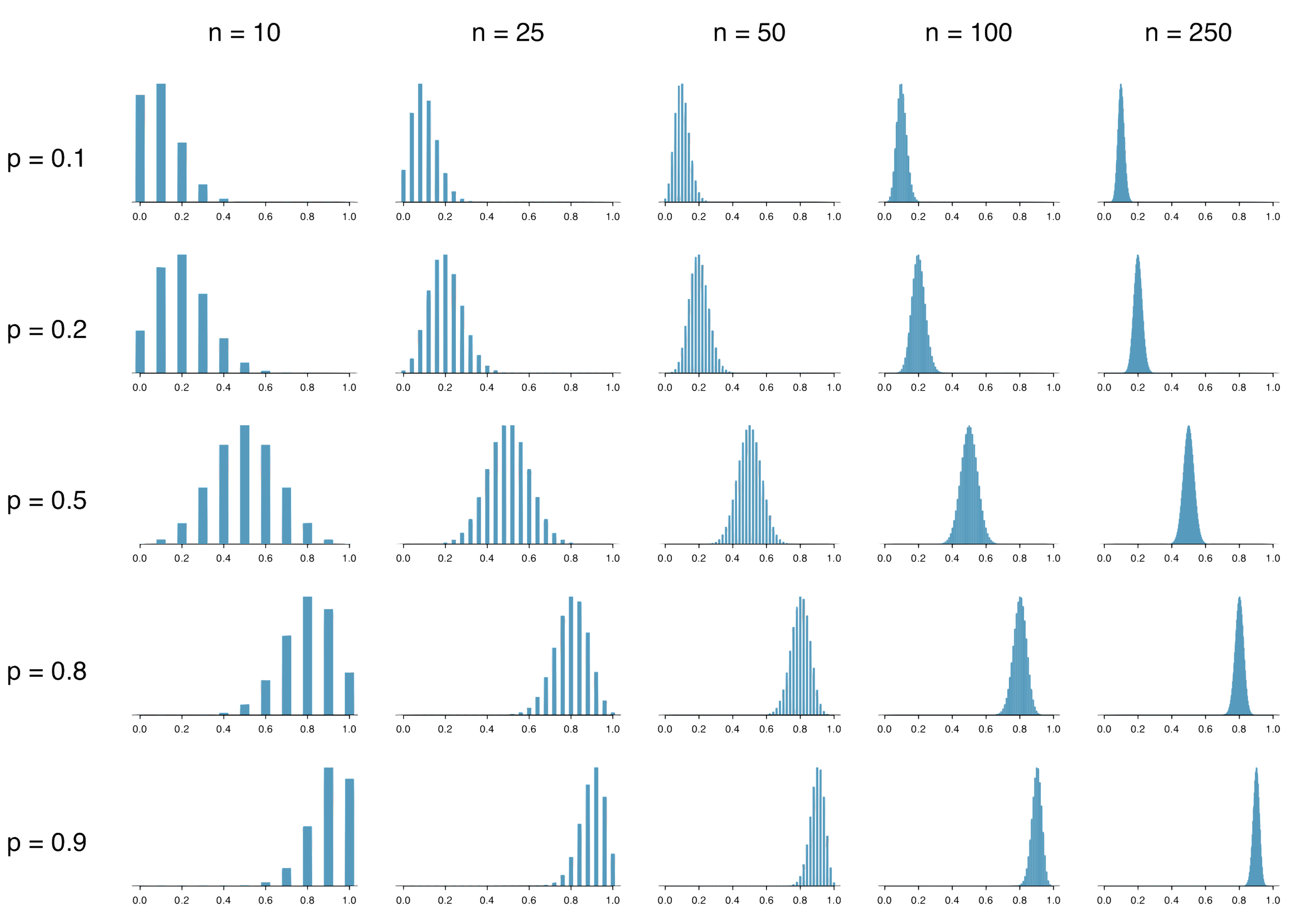
What happens when np and/or n(1 − p) < 10

Slide 55
When the conditions are not met...
When either np or n(1 − p) is small, the distribution is more discrete.
When np or n(1 − p) < 10, the distribution is more skewed.
The larger both np and n(1 − p), the more normal the
distribution.
When np and n(1 − p) are both very large, the discreteness of the distribution is hardly evident, and the distribution looks much more like a normal distribution.

Slide 56
Extending the framework for other statistics
The strategy of using a sample statistic to estimate a parameter is quite common, and it’s a strategy that we can apply to other statistics besides a proportion.
Take a random sample of students at a college and ask them how many extracurricular activities they are involved in to estimate the average number of extra curricular activities all students in this college are interested in.
The principles and general ideas are from this chapter apply to other parameters as well, even if the details change a little.

Slide 57
Find more resources at openintro.org/os, including
Slides
Videos
Statistical Software Labs
Discussion Forums (free support for students and teachers)
Learning Objectives
Teachers only content is also available for Verified Teachers, including
Exercise solutions
Sample exams
Ability to request a free desk copy for a course
Statistics Teachers email group
Questions? Contact us.

Slide 58
Extra Slides from the OS3 section on point estimates

Slide 59
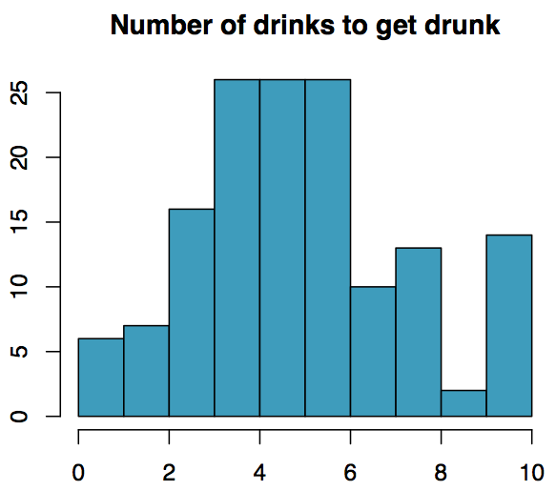
Practice
The following histogram shows the distribution of number of drinks it takes a group of college students to get drunk. We will assume that this is our population of interest. If we randomly select observations from this data set, which values are most likely to be selected, which are least likely?

Slide 60
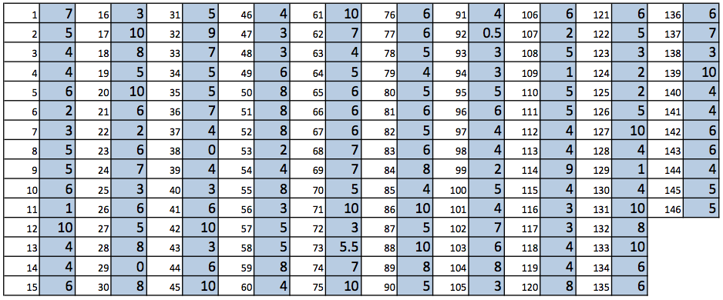
Suppose that you don't have access to the population data. In order to estimate the average number of drinks it takes these college students to get drunk, you might sample from the population and use your sample mean as the best guess for the unknown population mean.
Sample, with replacement, ten students from the population, and record the number of drinks it takes them to get drunk.
Find the sample mean.
Plot the distribution of the sample averages obtained by members of the class.

Slide 61
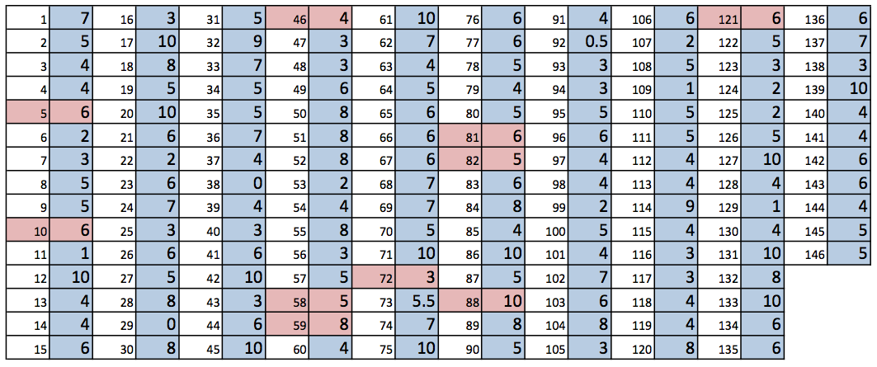
Example
List of random numbers: 59, 121, 88, 46, 58, 72, 82, 81, 5, 10

Slide 62
Example
List of random numbers: 59, 121, 88, 46, 58, 72, 82, 81, 5, 10
Sample mean: (8+6+10+4+5+3+5+6+6+6) / 10 = 5.9

Slide 63
Sampling distribution
What you just constructed is called a sampling distribution.

Slide 64
Sampling distribution
What you just constructed is called a sampling distribution.
What is the shape and center of this distribution? Based on this distribution, what do you think is the true population average?

Slide 65
Sampling distribution
What you just constructed is called a sampling distribution.
What is the shape and center of this distribution? Based on this distribution, what do you think is the true population average?
Approximately 5.39, the true population mean.

Slide 66
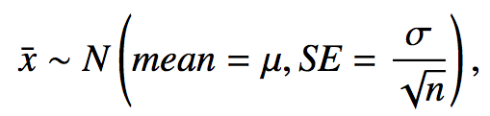
Central Limit Theorem
The distribution of the sample mean is well approximated by a normal model:
where SE is represents standard error, which is defined as the standard deviation of the sampling distribution. If σ is unknown, use s.
It wasn't a coincidence that the sampling distribution we saw earlier was symmetric, and centered at the true population mean.
We won't go through a detailed proof of why SE = σ / √n, but note that as n increases SE decreases.
As the sample size increases we would expect samples to yield more consistent sample means, hence the variability among the sample means would be lower.

Slide 67
CLT - conditions
Certain conditions must be met for the CLT to apply:
Independence: Sampled observations must be independent. This is difficult to verify, but is more likely if
random sampling / assignment is used, and
if sampling without replacement, n < 10% of the population.

Slide 68
CLT - conditions
Certain conditions must be met for the CLT to apply:
Independence: Sampled observations must be independent. This is difficult to verify, but is more likely if
random sampling / assignment is used, and
if sampling without replacement, n < 10% of the population.
Sample size / skew: Either the population distribution is normal, or if the population distribution is skewed, the sample size is large.
the more skewed the population distribution, the larger sample size we need for the CLT to apply
for moderately skewed distributions n > 30 is a widely used rule of thumb
This is also difficult to verify for the population, but we can check it using the sample data, and assume that the sample mirrors the population.

